Slide 1

UNIVERSITI TEKNOLOGI MALAYSIA
NUTRITIONAL DEFICIENCY PREDICTION BY REGION USING MACHINE LEARNING
ANNE DASHINI KANNAN
MCS241013
RESEARCH DESIGN AND ANALYSIS IN DATA SCIENCE (THESIS)

Slide 2
INTRODUCTION

Slide 3
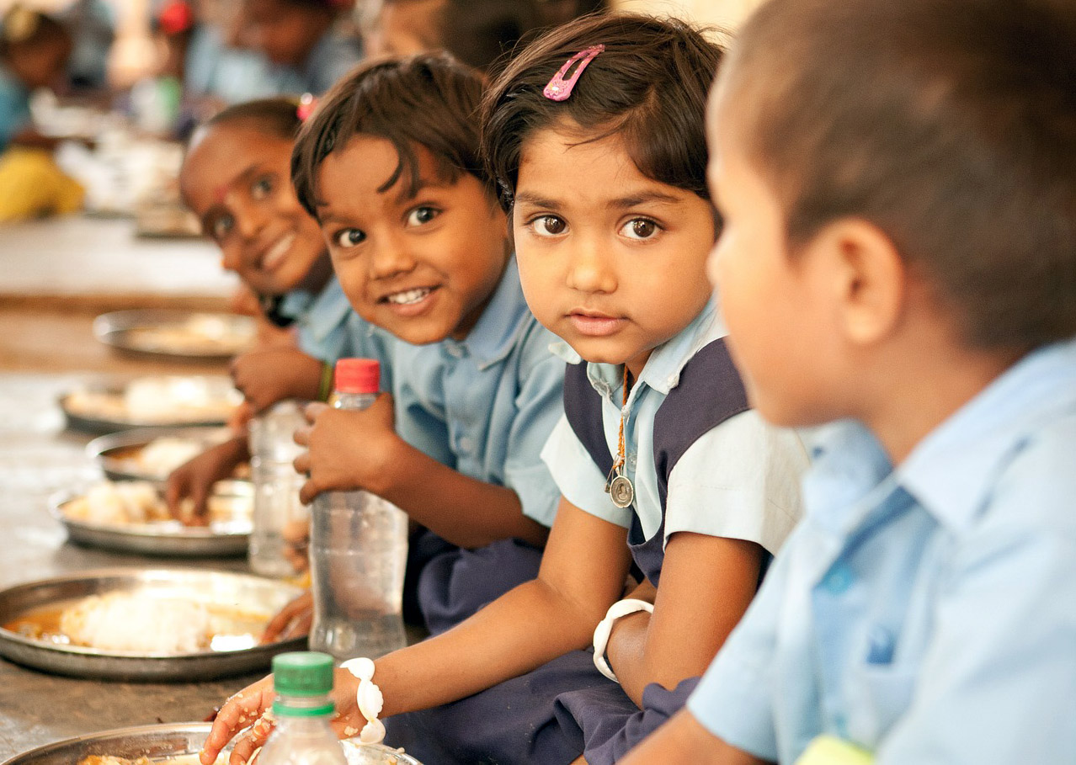
Nutritional Deficiency is one of the global issues in human health growth due to specific reasons and factors

Slide 4

These deficiencies can lead to serious health issues among our human populations.

Slide 5

Several ways has been carrried out to detect the nutrition deficiency ,however it tend to be expensive and inefficient since these type of issues needed imeediate solutions to solve it .

Slide 6
PROBLEM BACKGROUND
Existing methods are resource-intensive, lack scalability, and do not integrate diverse datasets effectively.
Issues related with health condition require immediate actions.

Slide 7
Objectives
1. Identify key factors contributing to nutritional deficiencies.
2. Develop predictive models using ML techniques.
3. Create an interactive dashboard for visualization and decision-making.

Slide 8
Research Question
How can machine learning techniques predict nutritional deficiencies effectively?
What datasets are required for accurate models?
What challenges arise in real-world healthcare applications?
Who are the target groups for this prediction model?

Slide 9
LITERATURE REVIEW

Slide 10
Literature Review
Applications of ML in Healthcare
Research Gaps
Ssignificance
Supervised Learning: Random Forest, SVM, Gradient Boosting for predicting deficiencies.
- Deep Learning: CNNs and RNNs for large datasets (e.g., images, time-series).
- Unsupervised Learning: Clustering (e.g., K-means) to identify high-risk regions.
Limited comprehensive models addressing multiple deficiencies.
Challenges in data quality and ethical considerations.
Underexplored multimodal approaches for diverse datasets
Facilitates targeted resource allocation for healthcare providers, NGOs, and policymakers.
Promotes health equity by addressing nutritional gaps in vulnerable regions.
Aligns with UN Sustainable Development Goals (e.g., hunger reduction and improved well-being).

Slide 11
RESEARCH METHODOLOGY

Slide 12
Research Framework
1. Planning: Identify malnutrition issues, define research questions.
2. Data Preparation: Collect, clean, and preprocess datasets.
3. Feature Engineering: Key variables like dietary diversity, income, healthcare access.
4. Model Development: Supervised ML and clustering (K-means, Hierarchical).
5. Model Evaluation: Metrics: Accuracy, Precision, Recall, F1-Score, Cross-validation.
Tools: Python libraries (Scikit-learn, TensorFlow, Pandas, Matplotlib).
Dataset Sources: WHO, health surveys, and nutritional databases.

Slide 13
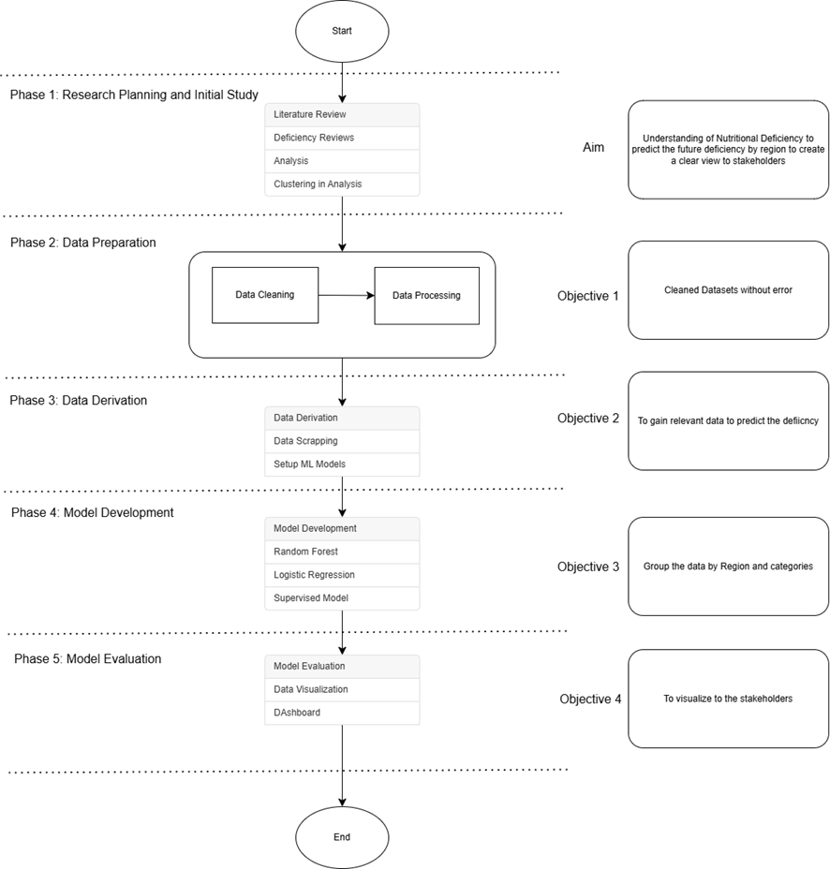
RESEARCH FRAMEWORK

Slide 14
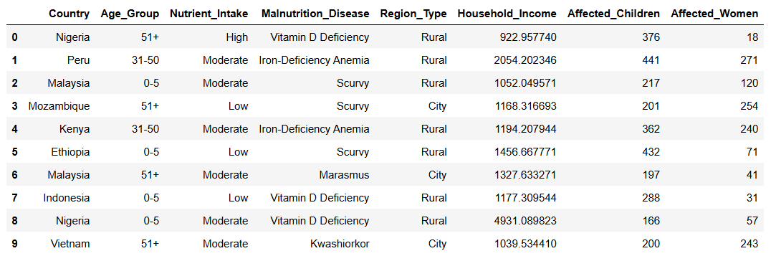
List Data collected Our World in Data Org

Slide 15
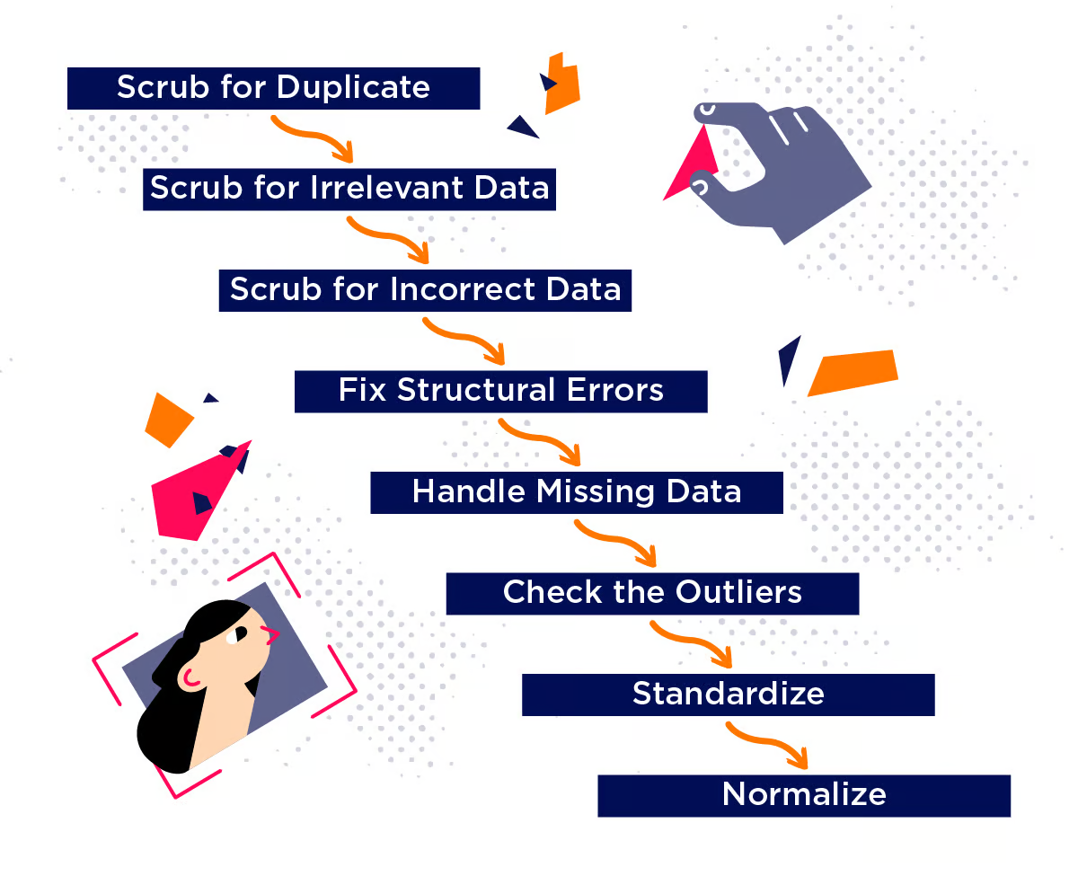
DATA CLEANING

Slide 16
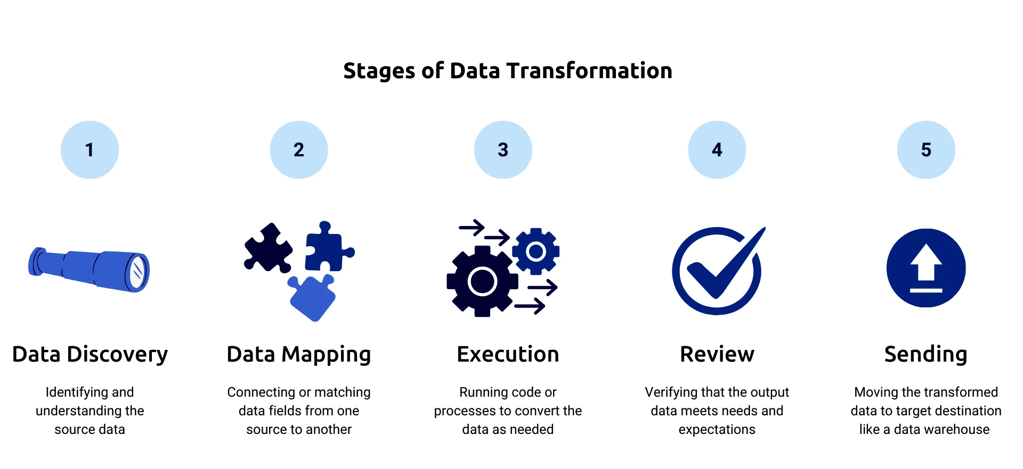
DATA TRANSFORMATION

Slide 17
INITIAL RESULTS

Slide 18
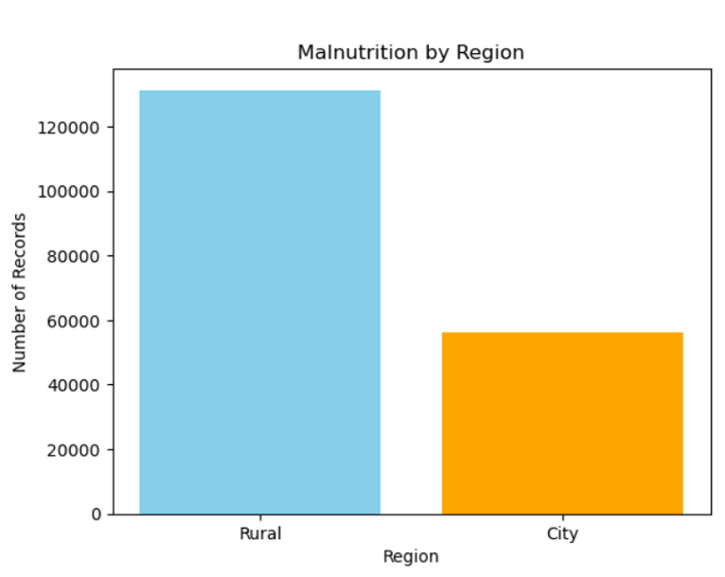
Malnutrition By Region

Slide 19
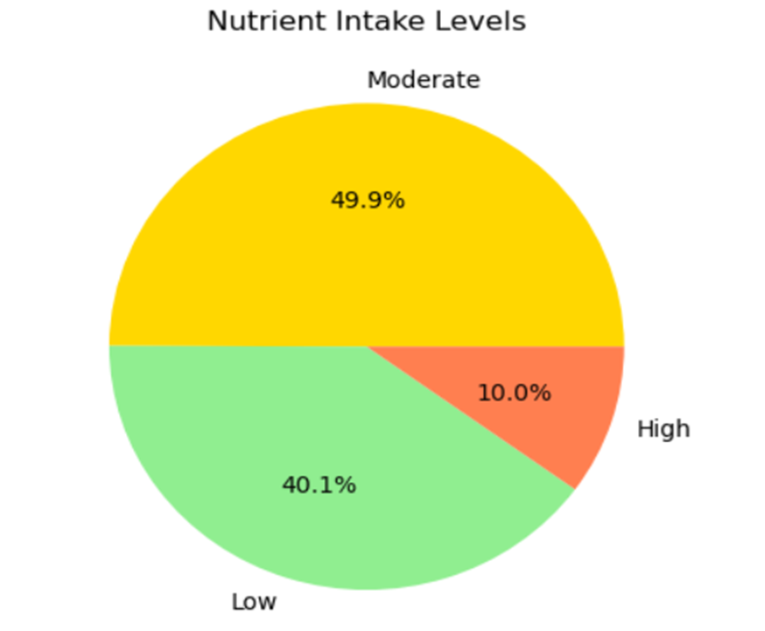
Nutrition Intake Level

Slide 20
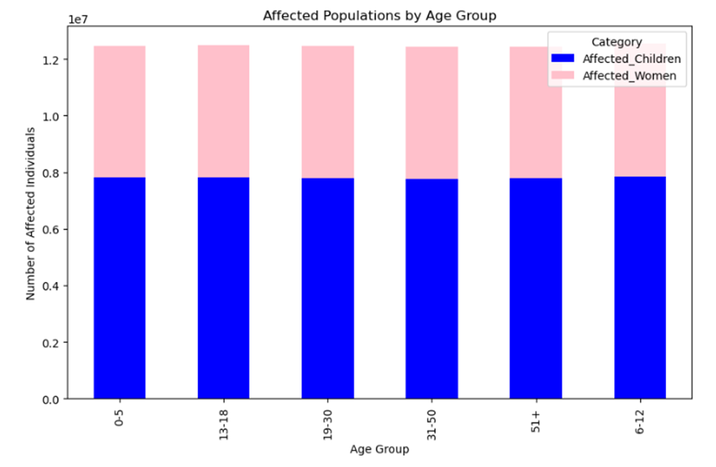
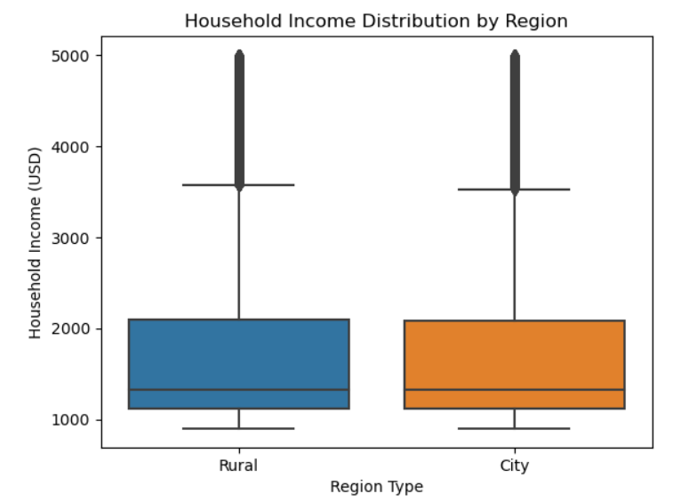
Affected Population By Age Group
Household Income Distribution by Region

Slide 21
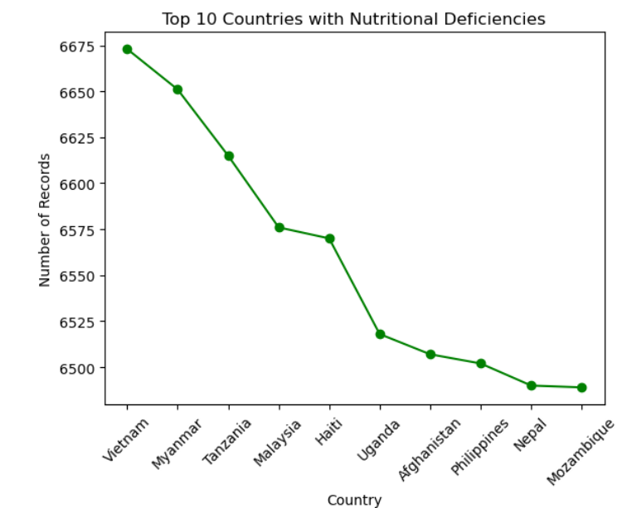
Affected Population By Age Group
Top 10 Countries with Nutritional Deficiences

Slide 22
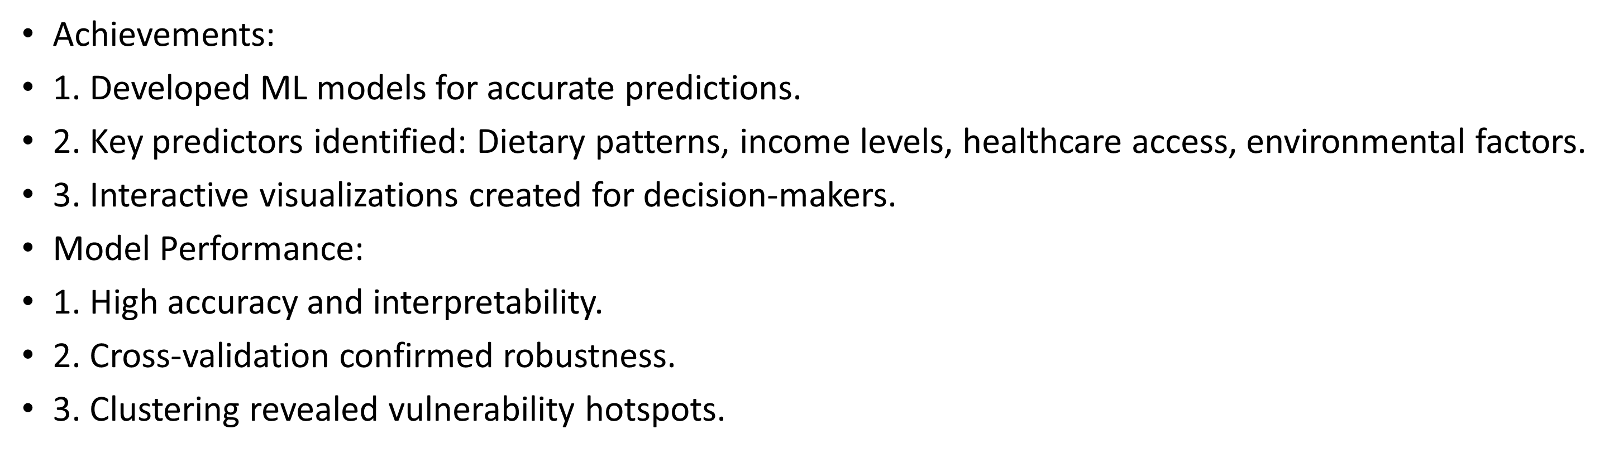
Results and Achievements

Slide 23
Future Work and Recommendations
Future Directions:
1. Incorporate real-time and larger datasets.
2. Add environmental and cultural variables for deeper insights.
3. Use advanced ML methods like ensemble and deep learning for better performance.
4. Develop sub-regional analysis for granular predictions.
5. Collaborate with policymakers for region-specific interventions.

Slide 24
Summary
Machine learning provides a data-driven approach to combating malnutrition.
This research bridges technology and public health by predicting vulnerabilities and targeting interventions.
Demonstrates potential to address global challenges and improve health outcomes sustainably.

Slide 25


Thank You.
utmofficial
univteknologimalaysia
utm.my
https://youtu.be/52MwCZ2XPic

